Slide 1
Report
Application for predicting the Length of Stay of a patient.
- Siddhant Bane

Slide 2
Database Cleaning
The process followed for data cleaning phase 1 have been detailed out in the previous output report. (named: initial_report.pptx)
In phase 2, first the gender of the patient was included by connecting the ADMISSIONS.csv and PATIENTS.csv tables.
Using SUBJECT_ID as the foreign key, the gender information was provided for every row in ADMISSIONS.csv table. The table is then saved as: ADMISSIONS_GEN.csv

Slide 3
Understanding the Data
Initially 6 attributes were considered for the training of the prediction model:
ADMISSION TYPE
ADMISSION_LOCATION
DISCHARGE_LOCATION
INSURANCE
ETHNICITY
EDLOS (in minutes)
The prediction is going to be made on the length of stay of the patients (LOS) in days.

Slide 4
Understanding the Data
Description of these attributes according to the MIMIC documentations.
ADMISSION_TYPE describes the type of the admission: ‘ELECTIVE’, ‘URGENT’, ‘NEWBORN’ or ‘EMERGENCY’. Emergency/urgent indicate unplanned medical care, and are often collapsed into a single category in studies. Elective indicates a previously planned hospital admission. Newborn indicates that the case pertains to the patient’s birth.
ADMISSION_LOCATION provides information about the previous location of the patient prior to arriving at the hospital. There are 9 possible values:
EMERGENCY ROOM ADMIT
TRANSFER FROM HOSP/EXTRAM
TRANSFER FROM OTHER HEALT
CLINIC REFERRAL/PREMATURE
** INFO NOT AVAILABLE **
TRANSFER FROM SKILLED NUR
TRSF WITHIN THIS FACILITY
HMO REFERRAL/SICK
PHYS REFERRAL/NORMAL DELI

Slide 5
Understanding the Data
The INSURANCE and ETHNICITY columns describe patient demographics.
EDLOS (in minutes) is calculated from EDREGTIME, EDOUTTIME, which are the time that the patient was registered and discharged from the emergency department.
Finally LOS (in days) is calculated from ADMITTIME, DISCHTIME. Here, ADMITTIME provides the date and time the patient was admitted to the hospital, while DISCHTIME provides the date and time the patient was discharged from the hospital.

Slide 6
Understanding the Data
Further, 2 more attributes were considered. These being:
DIAGNOSIS: The DIAGNOSIS column provides a preliminary, free text diagnosis for the patient on hospital admission. The diagnosis is usually assigned by the admitting clinician and does not use a systematic ontology.
GENDER: As previously mentioned, the gender of the patient is looked up from the PATIENTS.csv table using SUBJECT_ID as foreign key, and applying inner join in ADMISSIONS.csv table.

Slide 7
Attribute analysis
ADMISSION_TYPE : Categorical (categories=4)
ADMISSION_LOCATION : Categorical (categories=8)
DISCHARGE_LOCATION : Categorical (categories=17)
INSURANCE : Categorical (categories=5)
ETHNICITY : Categorical (categories=40)
EDLOS: Continuous (unit = minutes)
GENDER : Categorical (categories=2)
DIAGNOSIS : Categorical (categories=15692)
Note: Since the Diagnosis attribute has a very high number of categories, with a very high class bias, further exploration is needed.

Slide 8
Diagnosis Attribute
Since the Diagnosis attribute has a very high number of categories, with a very high class bias, further exploration is needed.
The data has a high class bias as a very small number of categories have a large number of cases belonging to them. This can be seen in the output in next slide:
Due to this, we are considering the records with the top 30 diagnosis which occur more than at least 200 times in the data set.

Slide 9
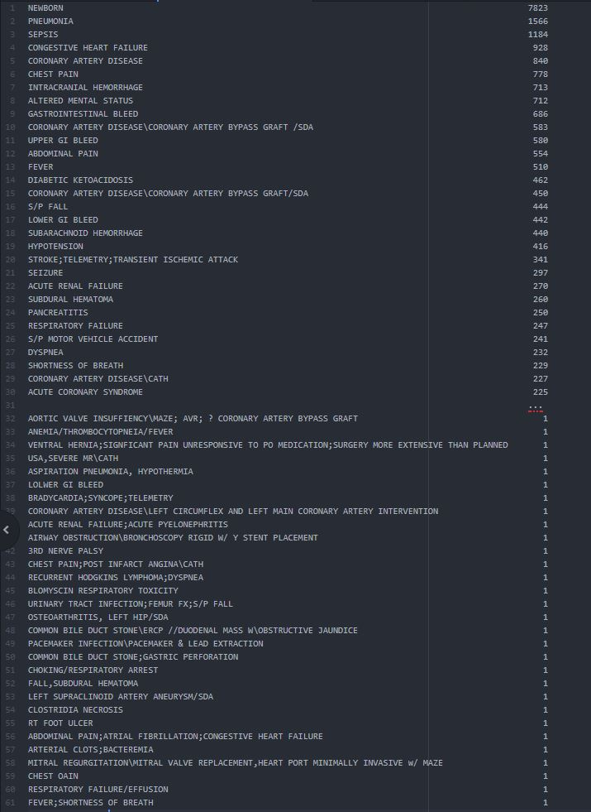

Slide 10
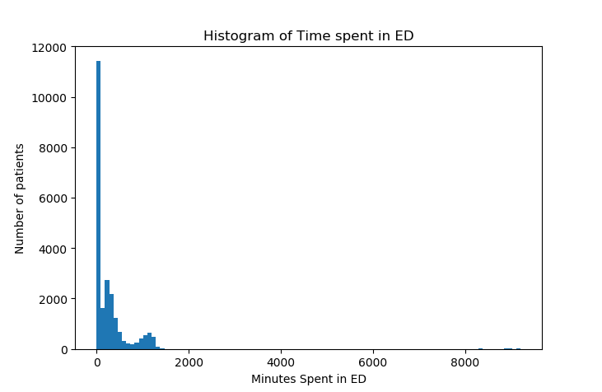
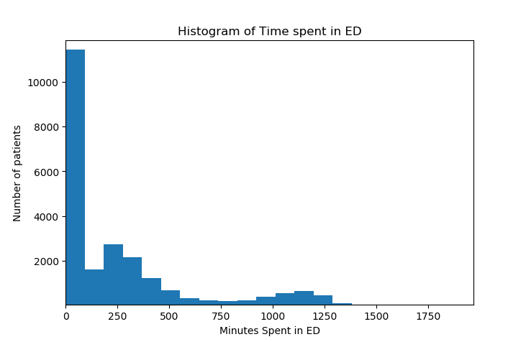
EDLOS
EDLOS is the total time spent by the patient in the Emergency Department in minutes.
It is calculated from EDREGTIME, EDOUTTIME attributes of the ADMISSIONS.csv table.
Note: Meta Data of EDLOS described in image: EDLOSmetadata.jpg

Slide 11
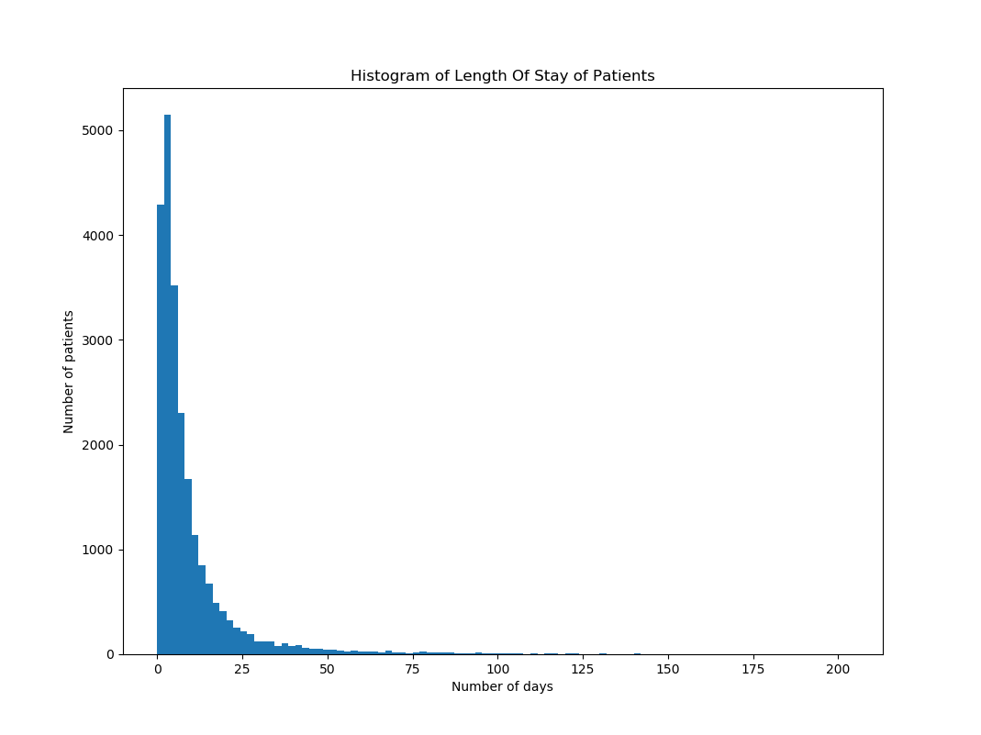
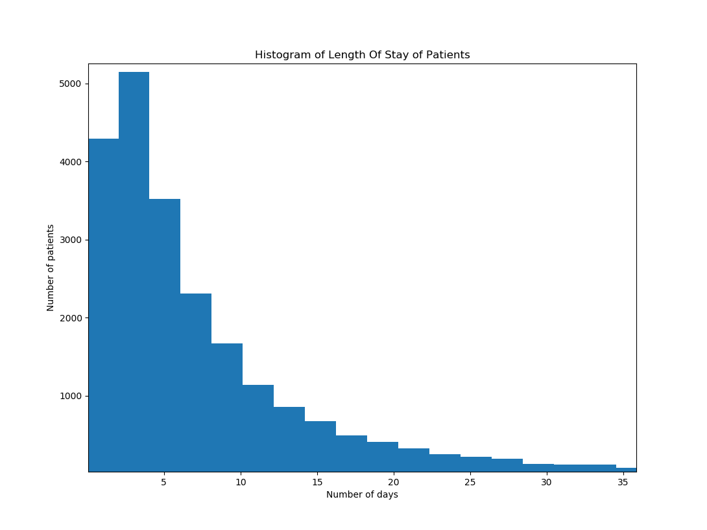
LOS
LOS is the total number of days spent by the patient in the hospital.
It is calculated form the ADMITTIME, DISCHTIME attributes of the ADMISSIONS.csv table.
Note: Meta Data of LOS described in image: LOSmetadata.jpg

Slide 12
Regression Model
Used the input dataset to train a Linear Regression model and a BPNN Regression model.
Batch size = 500 and 1000
Epochs = 100
Shuffle = True
Training steps = 10000
For BPNN:
Hidden units = (8,8,8,8)

Slide 13
Regression Model Results
BPNN Regression Model:
Average Training loss: 100.67
Average Eval loss: 120.78
RMSE: 10.99 days
Linear Regression Model:
Average Training loss: 70.591
Average Eval loss: 131.61
RMSE: 11.47 days
Comparing the training loss with eval loss, we can tell that the model is over fitting due to data sparsity. Even changing the batch size yielded similar results.

Slide 14
Classification Model
We converted the prediction problem into a classification problem. Here we are estimating if the patient will stay for less than or more than x number of days.
This value of x can be decided based on the requirement of the hospital.
For our case, we assume x=6, i.e. we are able to predict if the incoming patient is going to stay for more than 6 days, or less than 6 days.
If the patient is found to be staying for less than 6 days, the input set can be further classified for values of 1<x<6, assuming that the patient will stay at the hospital for at least 1 day.
If the patient is found to be staying for more than 6 days, it can be handled by preparing for the 6 day stay, and then the decision on the LOS can be put up to the doctor’s discretion.

Slide 15
Classification Model
Various combinations of splits for the classes were tried, like 0-7-28-MAX, 0-7-MAX, 0-10-MAX, 0-6-MAX, 0-4-MAX etc.
The results for each of these models, with different variations for the batch size, epochs, Neural Network makeup and number of steps are recorded into the record.xlsx file.
Ultimately, the prediction model takes in the input of a new patient.
These inputs are: Admission type, Admission location, Insurance, diagnosis (one of the 30 selected diagnosis types), ethnicity, gender, time spent in ED (if Admission type is ‘EMERGENCY’).

Slide 16
Classification Model
Upon taking these inputs, predictor is called and it will predict the LOS of the patient in days within the range of 2 to 6 days, with the probability of patient staying till that day, along with displaying the accuracy of the model.
Accuracy of the final Model for 6 day split: 72%
Accuracy of the final Model for 4 day split: 75%
Probabilities for a given input set is displayed in the application screenshots

